Slide 1

Extracting Visual Insight from Multiple Data Sets and Data Mashups
September 11, 2018
Brad Llewellyn
Senior Analytics Associate – Data Science
Syntelli Solutions

Slide 2





MCSE: Data Management and Analytics
MCSE: Cloud Platform and Infrastructure
MCSA: SQL Server 2012/2014
MCSA: Cloud Platform
MCSA: Machine Learning
MCSA: SQL 2016 BI Development
M.S. Statistics: University of South Carolina
Analytics Consultant – 5.5 Years
Syntelli Solutions – <6 Months
@BreakingBI
https://www.linkedin.com/in/bradllewellyn
http://breaking-bi.blogspot.com
Llewellyn.wb@gmail.com
Charlotte BI Group Organizer - http://charbigroup.com
PASS Member and Speaker - https://www.pass.org
About Me
Brad Llewellyn
Senior Analytics Associate – Data Science
Syntelli Solutions

Slide 3



Agenda
Why Focus on Visual Analytics?
How Should I Change My Business Process?
How Can I Look At My Data Differently?

Slide 4
Why Focus on Visual Analytics?

Slide 5
What’s the Goal of Data?
To Inspire Action!

Slide 6
What’s the Goal of Data?
To understand the underlying process in order to make better decisions!

Slide 7
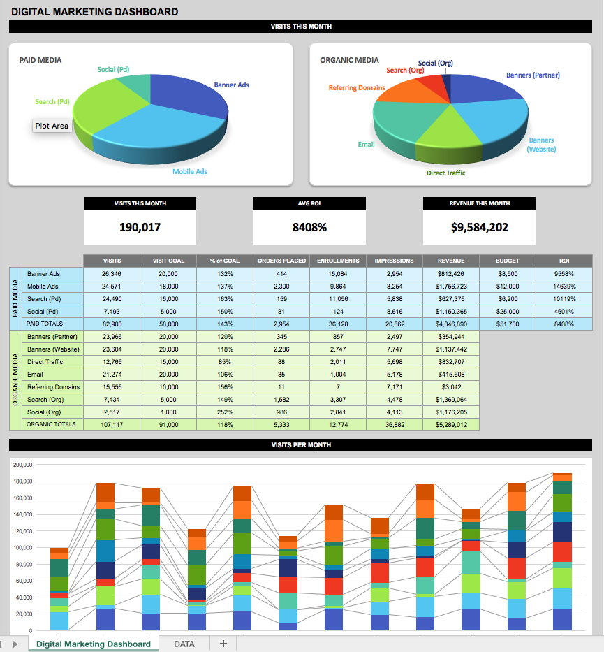
Why aren’t we there?

Slide 8
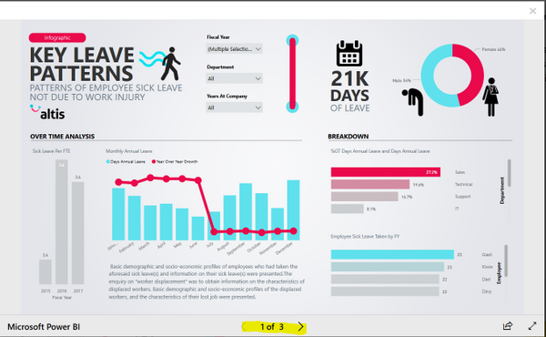
Why aren’t we there?

Slide 9
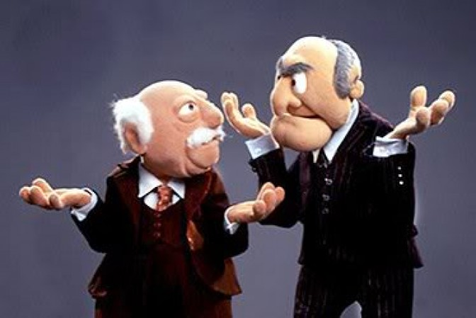

What do the consumers want?
Executives, Managers and Business Users
Want to save time
Want to identify valuable opportunities
Want to improve existing processes

Slide 10
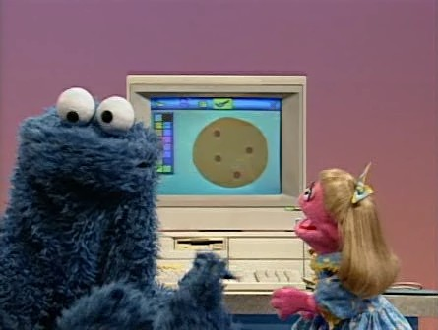

What do the developers want?
Analysts, Developers and IT
Want to drive adoption
Want to provide value
Want to learn new skills

Slide 11
How Should I Change My Business Process?

Slide 12
Typical Reporting Process
Gather Requirements
Create Report
Move to Next Report

Slide 13
Visual Analysis Process
Gather Context
Create Analytic Story
Iterate

Slide 14
Typical Skillsets
Data Analyst
Business
Context
Technology
Business Analyst
Report Developer

Slide 15
Typical Skillsets
Visual Design
Technology
Business Context
Marketing
Designer
User Experience
(UX) Designer
Visual
Storyteller
Data Analyst

Slide 16
How Can I Look At My Data Differently?

Slide 17
Design Choices
Use Pleasing and Informative Color Palettes
Create Intuitive Design Patterns
Provide Context on Hover
Drilldown and Drillthrough for Details
Provide Buttons and Interactive/Guided Journeys

Slide 18
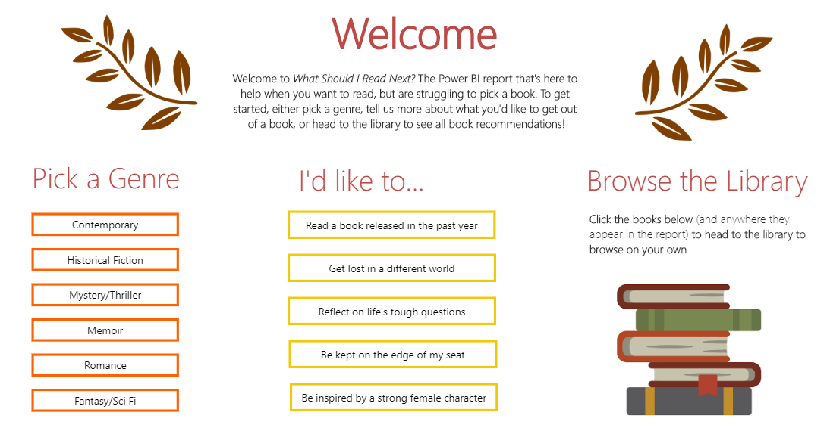

Slide 19
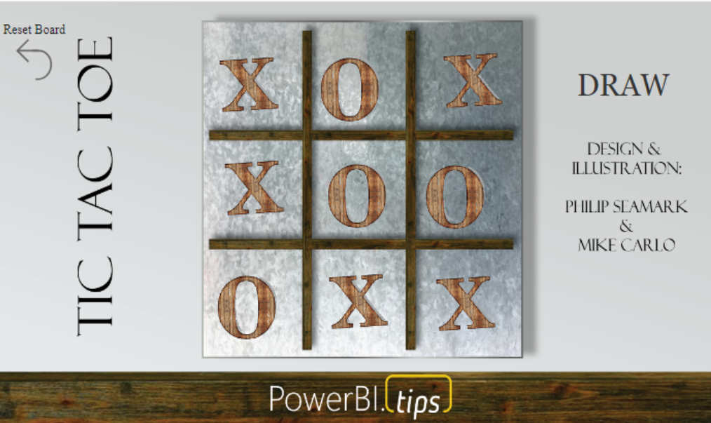

Slide 20
Thank You!
Brad Llewellyn
Senior Analytics Associate – Data Science
Syntelli Solutions
@BreakingBI
https://www.linkedin.com/in/bradllewellyn
http://breaking-bi.blogspot.com
Llewellyn.wb@gmail.com

